Slide 1

Say Hi to HiWire
HiWire Consortium to Enable Plug & Play
AEC Interconnects for High Speed Data Centers
TM

Slide 2
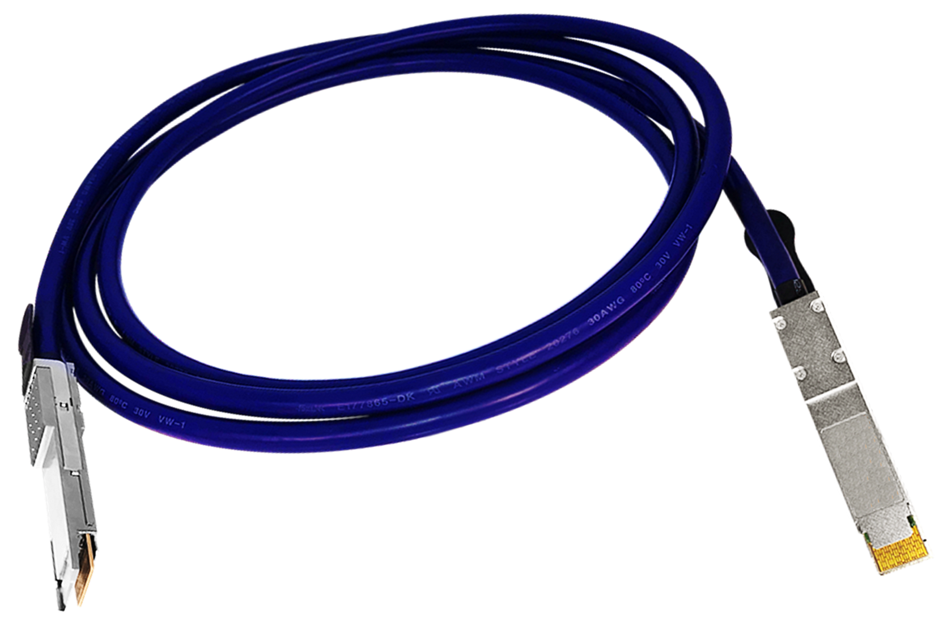

Introducing the HiWire Certified
Active Electrical Cable (AEC)

Slide 3
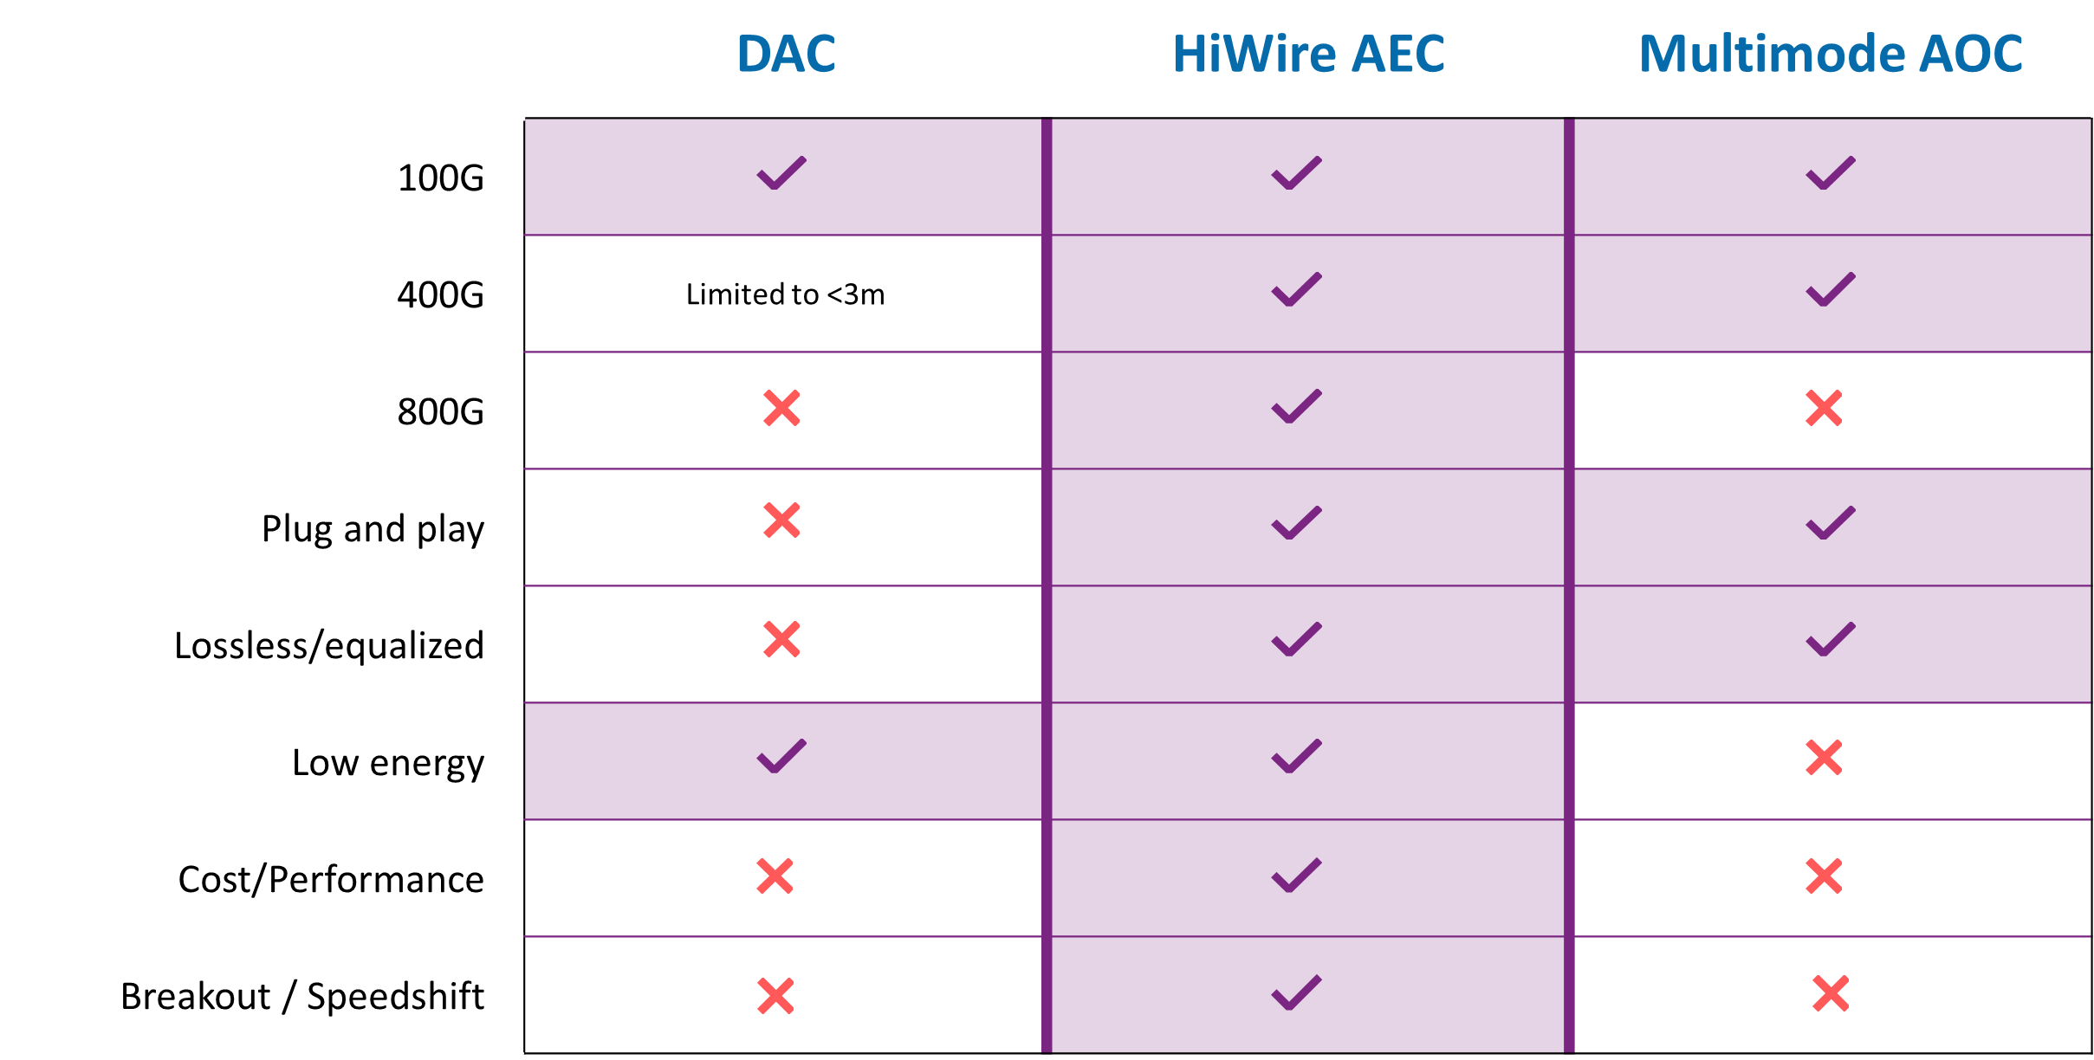

The Lowdown on HiWire AEC Cables

Slide 4


Consortium Objectives
Enable trusted AEC cables that always work
  Plug & play
HiWire AEC Spec
  New SNIA category
  Specific Parameters from existing MSAs
Certification test spec
  Specific tests on ref HW
  Qualification Flow (electrical, environmental, thermal)
Release Certified HiWire Mark
3rd Party Certification Lab
  Administered by respected 3rd parties (TUV, UL, Intertek, etc.)
Host plug-fests for HiWire certified components
  Cables, Cages, Systems
Market HiWire as a trusted, reliable interconnect solution

Slide 5
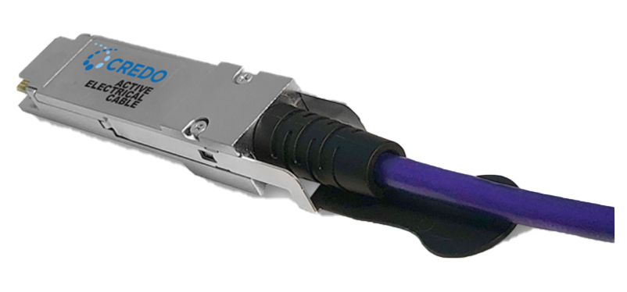

























Consortium
Founding Members

Slide 6
Consortium
Objective : Enable an ecosystem of plug & play certified AEC Cables
Model : USB-IF – Mutual Benefit Non-Profit
Initial BoD : Credo + Academia
Initial Funding : Credo Semiconductor
Trademarks :
TM
HiWire™

Slide 7
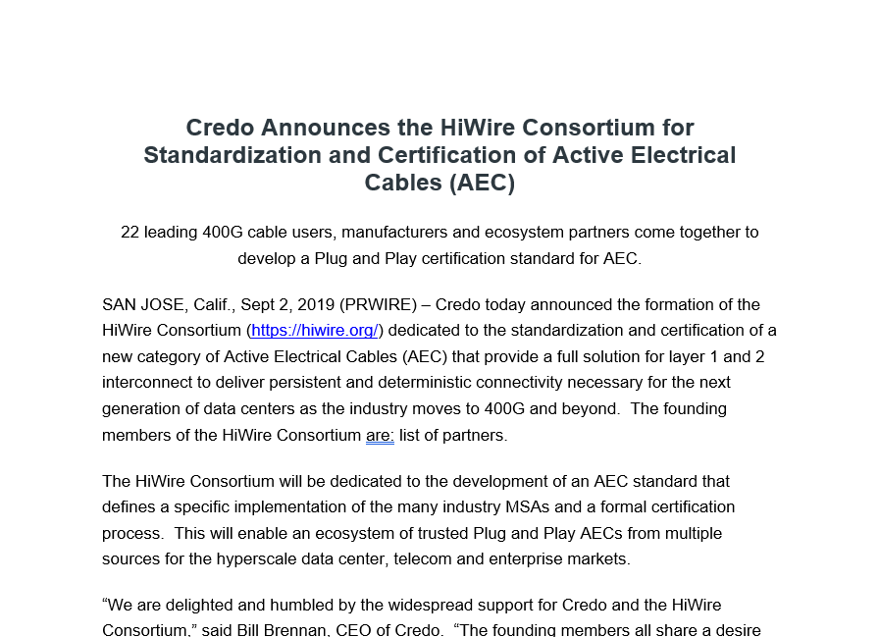
Consortium Launch PR

Slide 8

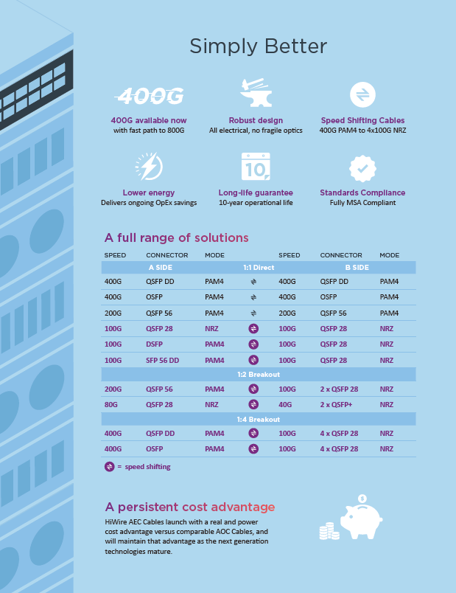
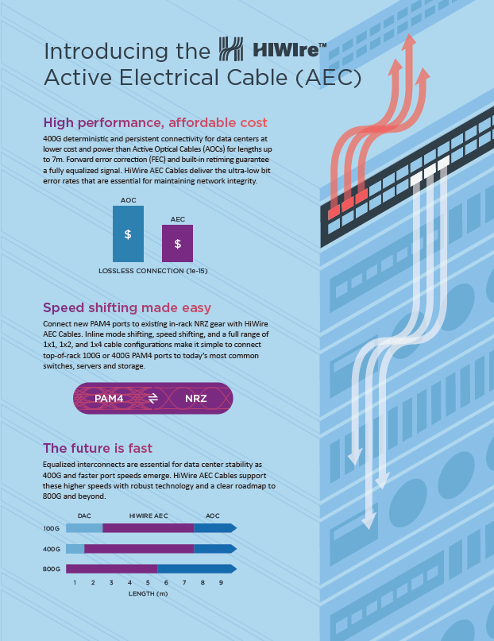
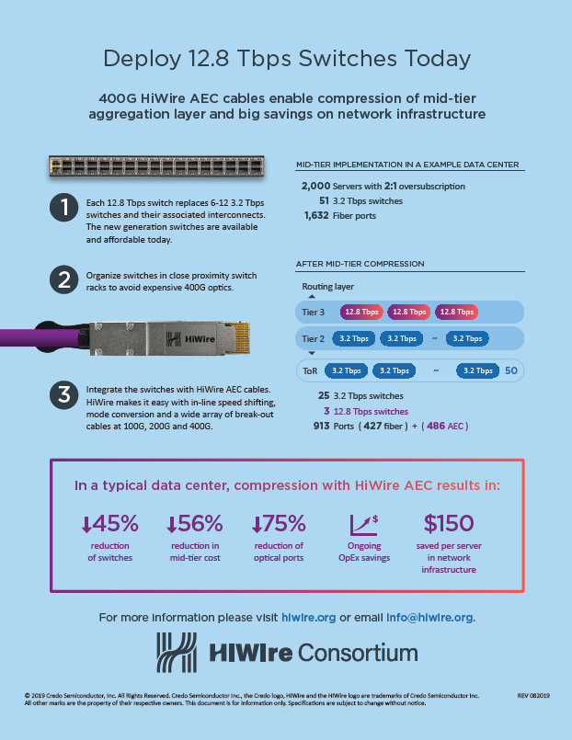
Consortium Brochure

Slide 9
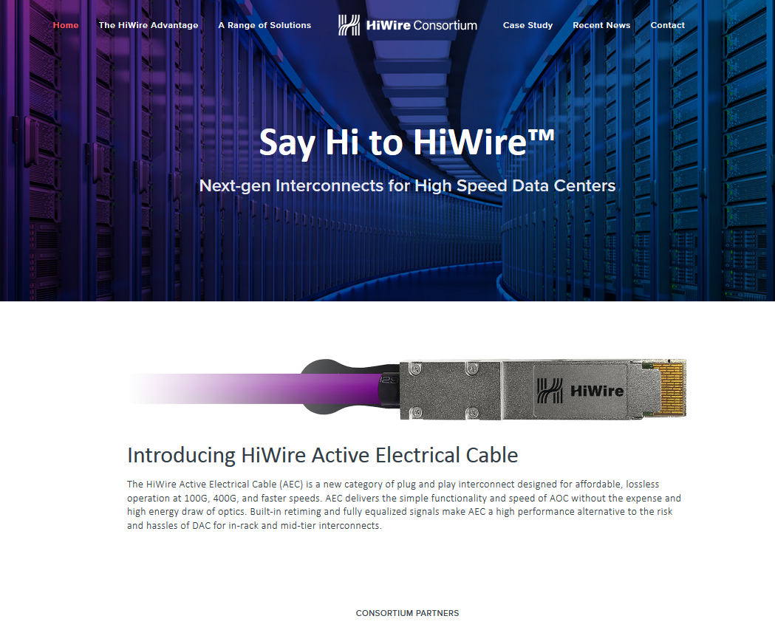
Consortium Website
Website:
www.hiwire.org
Email Inquiries:
info@hiwire.org

